Slide 1
Soft Computing and Its Applications in SE
Shafay Shamail
Malik Jahan Khan

Slide 2
Soft Computing
Difference with conventional computing
  Tolerant of imprecision
  Uncertainty
  Partial truth
  Approximation
  Vagueness

Slide 3
Basic Constituents of SC
Fuzzy Logic
Neural Computing
Evolutionary Computing
Machine Learning
Probabilistic Reasoning
Case-based Reasoning

Slide 4
Case-Based Reasoning
Case (Problem-Solution Pair)
Case repository
Similar problems have similar solutions
Notes:
When proposed
Who proposed
variations

Slide 5
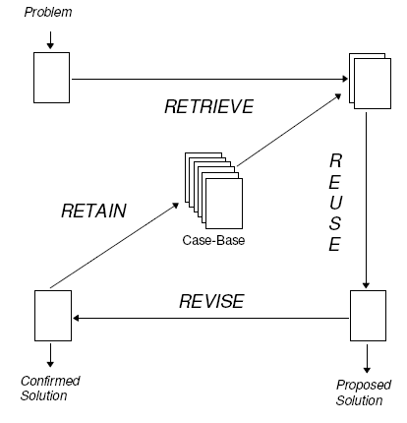
CBR Process
Source: A. Aamodt and E. Plaza. Case-based reasoning: Foundational issues, methodological variations, and system approaches. In AI Communications, volume 7:1, pages 39-59. IOS Press, March 1994.
Notes:
Issues in all phases

Slide 6
4 R’s Cycle
Retrieve
Reuse
Revise
Retain
Notes:
Survey of all phases

Slide 7
Retrieve
Nearest Neighborhood
  Current case is compared with existing cases in the case-base using some similarity measure
  Set of nearest neighbors is retrieved whose solution contributes to find the solution of current case using a solution algorithm

Slide 8
Similarity Measures
Euclidean Distance
Manhattan Distance
Mahalanobis Distance
Probabilistic Similarity Measure
Rule-based Similarity Measure
Notes:
Who proposed these measures and used for 1st time

Slide 9
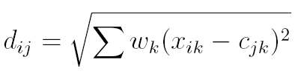
Euclidean Distance
d_{ij} = distance between i^{th} and j^{th} cases
w_{k} = weight of k^{th} parameter
x_{ik} = k^{th} parameter of i^{th} case in case-base
c_{jk} = k^{th} paramter of j^{th} case in question
Notes:
Issues in these measure identified from literature

Slide 10


Reuse
Solution Algorithm
  Unweighted average
  Weighted average
Notes:
After this list of issues identified

Slide 11
Revise
Revision Process/Adaptation
  What is changed in the solution
  How the change is achieved
Types of Adaptation
  Substitution
  Transformation
  Generative
Genetic Algorithms based Approach
Notes:
Substitution: Part of solution is changed
Transformation: Strucutre of the solution is changed
Generative: Replay the process of retrieval (Substitutes and transforms faulty parts of sol during replay)

Slide 12
Retain
Implicit assumption that solution was correct
Some output-verification mechanism is needed before decision about retention is taken
  Generalization of existing cases
  New case addition
  Learning algorithm is used to decide about retention

Slide 13
CBR and Software Engineering
Predictions
  Effort prediction
  Cost prediction
  Quality prediction
  Risk prediction
Software Reuse
Project Planning and Management
  E-Government: Decision Making
Autonomic Computing

Slide 14
Possible Directions of CBR
Adaptation Algorithms
  Domain specific (e.g. for autonomic computing)
Automatic Case Generation
CBR for non-numeric data
  Fuzziness
Similarity Measures
  Analysis of the tradeoff between complexity and accuracy
…

